Slide 1
Design Review
ECE 492 Team #11
Cameron Flores, Nestor Arellano, Ahmed Jaber, Michael Harm, Matthew Phillips, Zachary Solini

Slide 2
2) Needs and Requirements
Have the programming module communicate with the different devices
Have processing module to determine when to turn on the devices through relays and have all electrical connections be safe
Build fruit/vegetable storage containers for the fridge

Slide 3
2) Needs and Requirements...cont
2 Teams, A and B
Team A focuses on coding and testing, the electrical components are coded individually
Team B focuses on integrating the components with the fridge while making sure everything is protected

Slide 4
2) Need and Requirements...cont
Each team member shall take the lab safety training before using the bioengineering lab on GMU campus
Team members shall become familiar with components that will be used.
Team members should research specific nutritional information for potential produce to be stored properly in the product, i.e. What ideal temperature to preserve specific vitamins, etc.

Slide 5
3)Design Architecture
hu
DC Power
hu
Valve

Slide 6
3)Design Architecture...cont;

Slide 7
3)Design Architecture Cont...)

Slide 8
3)Design Architecture Cont...)

Slide 9
3)Design Architecture Cont...)

Slide 10
3)Design Architecture Cont...)

Slide 11
3)Design Architecture Cont...)

Slide 12
4) Background Knowledge...Temp/Humidity Sensor
Sensor submits data by the processing module sends out voltage through the device
Device sends out 5 sets of data (40 bits total)
8-bit data whole number humidity,
8-bit data decimal number humidity,
8-bit data whole number temperature,
8-bit data decimal number temperature
8-bit total result for checking
If total does not equal sum of 4 prior sets, it results in an error
[1] T. Liu. "Digital-output relative humidity & temperature sensor/module." Sparkfun.com. https://www.sparkfun.com/datasheets/Sensors/Temperature/DHT22.pdf

Slide 13
4) Example

Slide 14
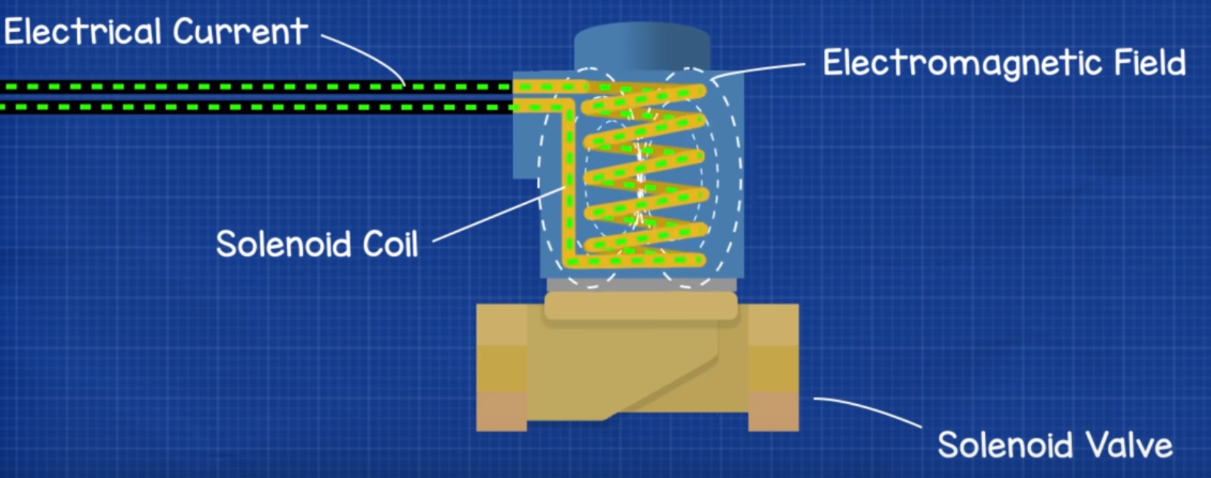
4) Background Knowledge...Solenoid Valve
Valve opens through a use of current running through the coil opening the valve, allowing airflow to run through
To close the valve, no current would not have to run
[2] The Engineering Mindset, How Solenoid Valves Work – Basics actuator control valve working principle. (Mar. 3, 2019). Accessed: Nov. 5, 2021. [Online Video]. Avalible: https://www.youtube.com/watch?v=-MLGr1_Fw0c&t=109s

Slide 15
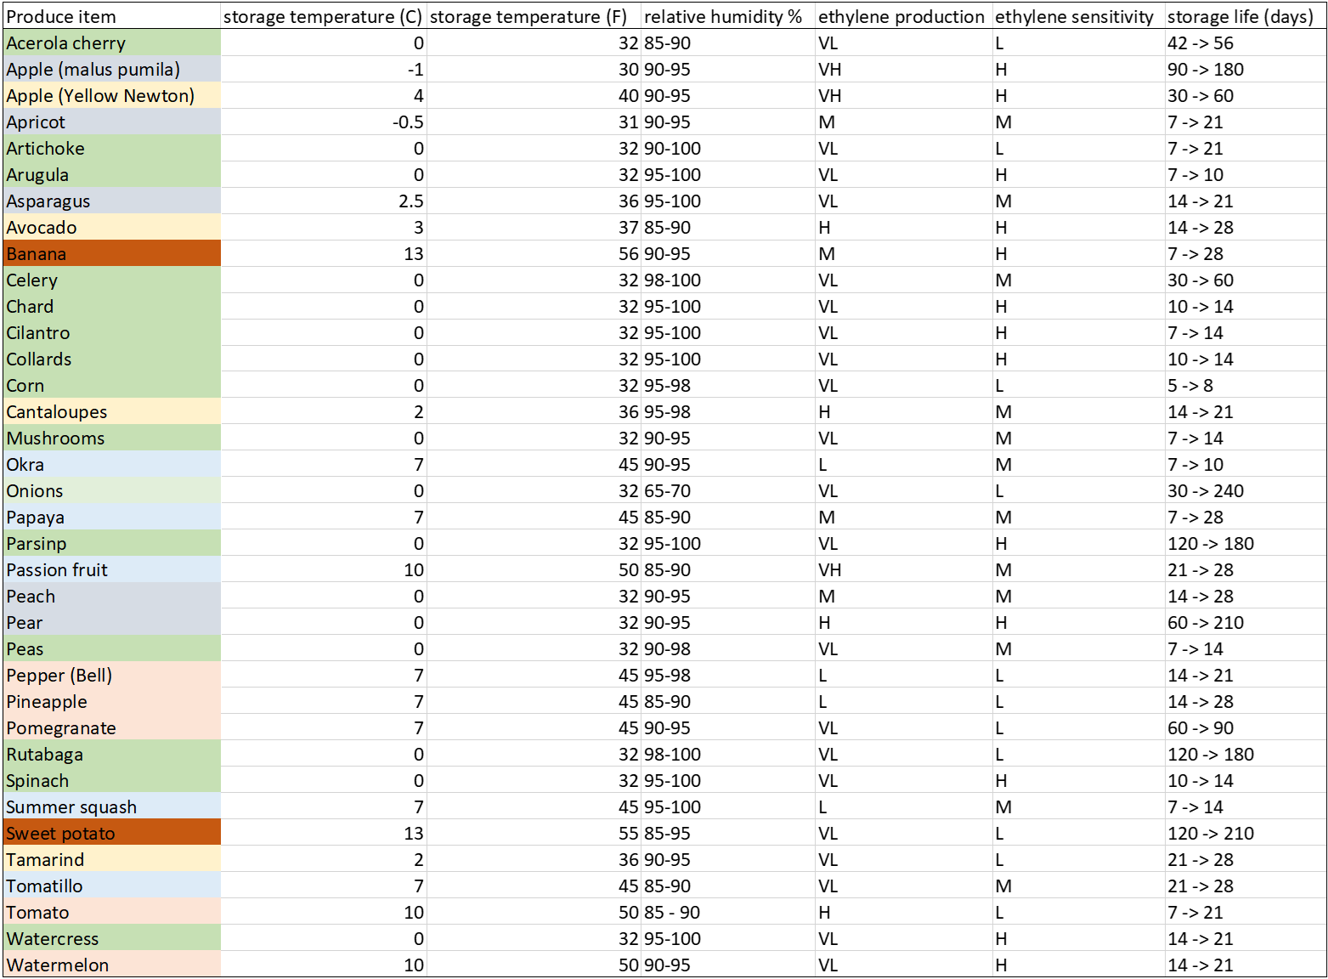
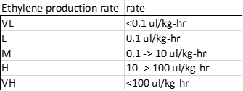
4) Background Knowledge...Food information
[3] A. A. Kader and M. Cantwell, “Appendix: Summary Table of Optimal Handling Conditions for Fresh Produce,” in Postharvest technology of Horticultural Crops, Third., vol. 3311, Oakland, CA: University of California, Agriculture and Natural Resources, 2002, pp. 511–518.

Slide 16
5) Detailed design (level 2) Accept user request
The user input to the system
By pressing buttons, the user will be able to select the corresponding optimal environments for different types of food to be placed in each compartment.
To make a better user-friendly experience, the inputs will be generalized into food types. For instance; greens, mushrooms, fruits, etc...

Slide 17
5) Detailed design (level 2) Reading temperature and humidity sensors.
The second input to the system is the data inputs from our temperature and humidity sensors.
Data needs to be gathered from each compartment in the fridge.

Slide 18
5) Detailed design (level 2) Controlling Environment selection
After the computer receives both the user inputs and the data inputs, it needs compare the inputs.
Based on this comparison the computer needs to send output signals to the refrigeration and mister controls.
If the inputs match, then the system goes into standby until the computer detects a difference in the user and data inputs.
If the inputs are different, then the system will turn on the refrigerator or mister.

Slide 19
5) Detailed design (level 2) Reading temp and humidity
Our display screen will give operational feedback to the user.
The display will show the preset selections, temperature, and humidity data for each compartment.

Slide 20
6)System Models
State Diagram

Slide 21
6)System Models Cont.
Flow Chart

Slide 22
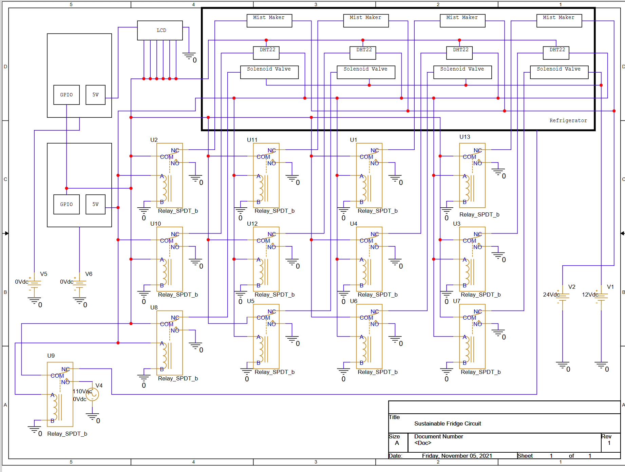
7) Schematics and Parts
GPIO cost: 23 pins

Slide 23
7) Individual chamber schematic

Slide 24
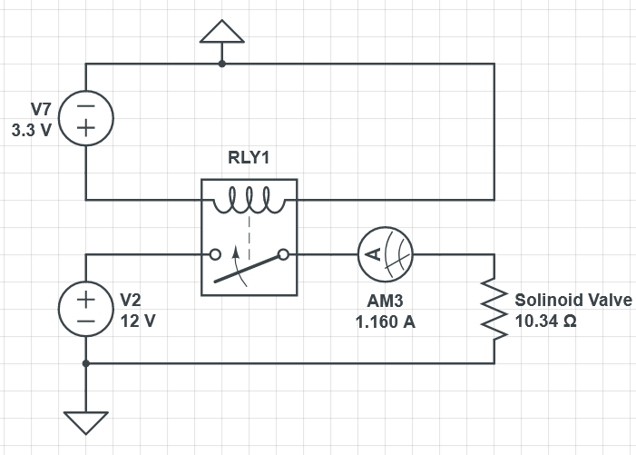
7) Circuit Diagrams
When using Mist Maker for humidity
When opening Solenoid Valve

Slide 25
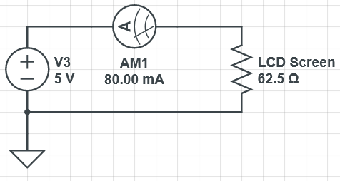
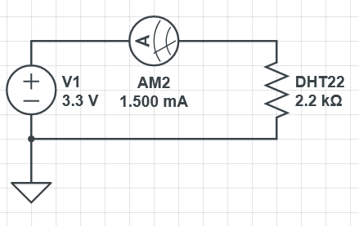
7) Circuit Diagram...cont
Constant Use of the LCD screen
When Using DHT22 to sense Temperature and humidty

Slide 26
Scenarios
Environment Adjustment
Solenoid Valve + Temp/Humidity Sensor +Mistmaker
Sensing
Temp/Humidity Sensor
LCD Screen will be constantly used in all scenarios

Slide 27
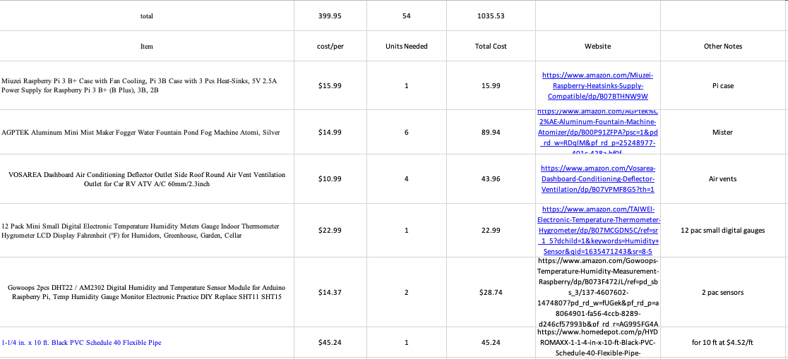
7) Part List

Slide 28
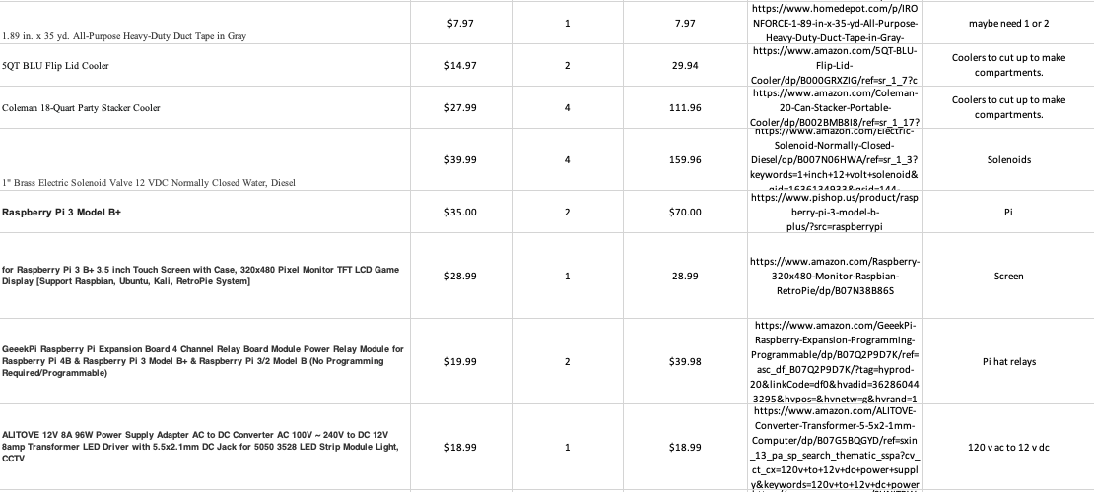
7)Part List cont'd

Slide 29
7)Part List cont'd

Slide 30
8) Prototyping Progress
Acquired components
Refrigerator
Raspberry Pi 3b+
DH22 and DH11 sensors
Character lcd screen
Currently working with PGF to obtain funding to purchase components for further testing

Slide 31
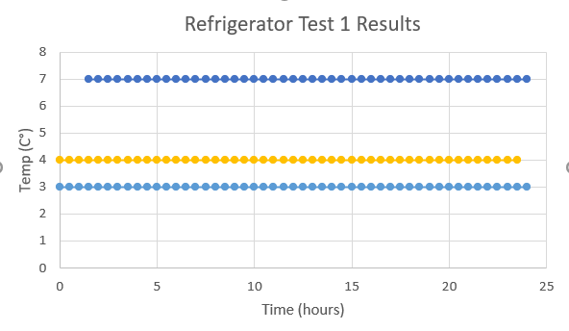
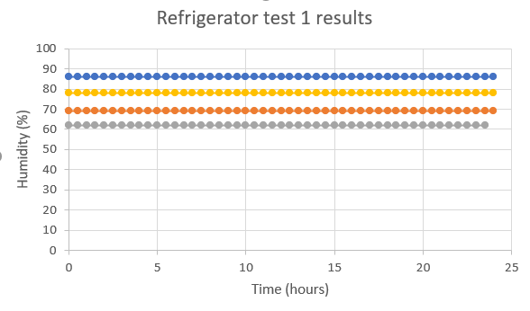
8) Prototyping – refrigerator data
First run of refrigerator tests:
Temperature and humidity in our refrigerators
Code output was a string, not a float leading to flat data
Further data gathering in progress
Results:
Litte fluctuation in our home refrigerators
Long term exposure to refrigerator condition did not negatively affect DH11 sensors
Future testing considerations

Slide 32
8) Prototyping: Experiments
Prototype of chamber
Internal temperature measured over 24 hours
Started at 23°C, added 7lbs of ice
Planning further experiments with humidity when parts are obtained

Slide 33
Prototyping plan:
Goal: To measure change in humidity using mister in chamber prototype and learn how to accurately control humidity
Components used: Polystyrene cooler, Raspberry Pi, temp/humidity sensor, mister
Testing process:
•Measure starting temp and humidity of cooler, before activating mister and measuring change that occurs
•Mister will operate until humidity reaches a certain threshold
•Measure how much humidity changes after mister is shut off
•Data collection will be repeated three times.
Evaluation: Focus on understanding how different inputs to the mister alter the humidity of the chamber.

Slide 34
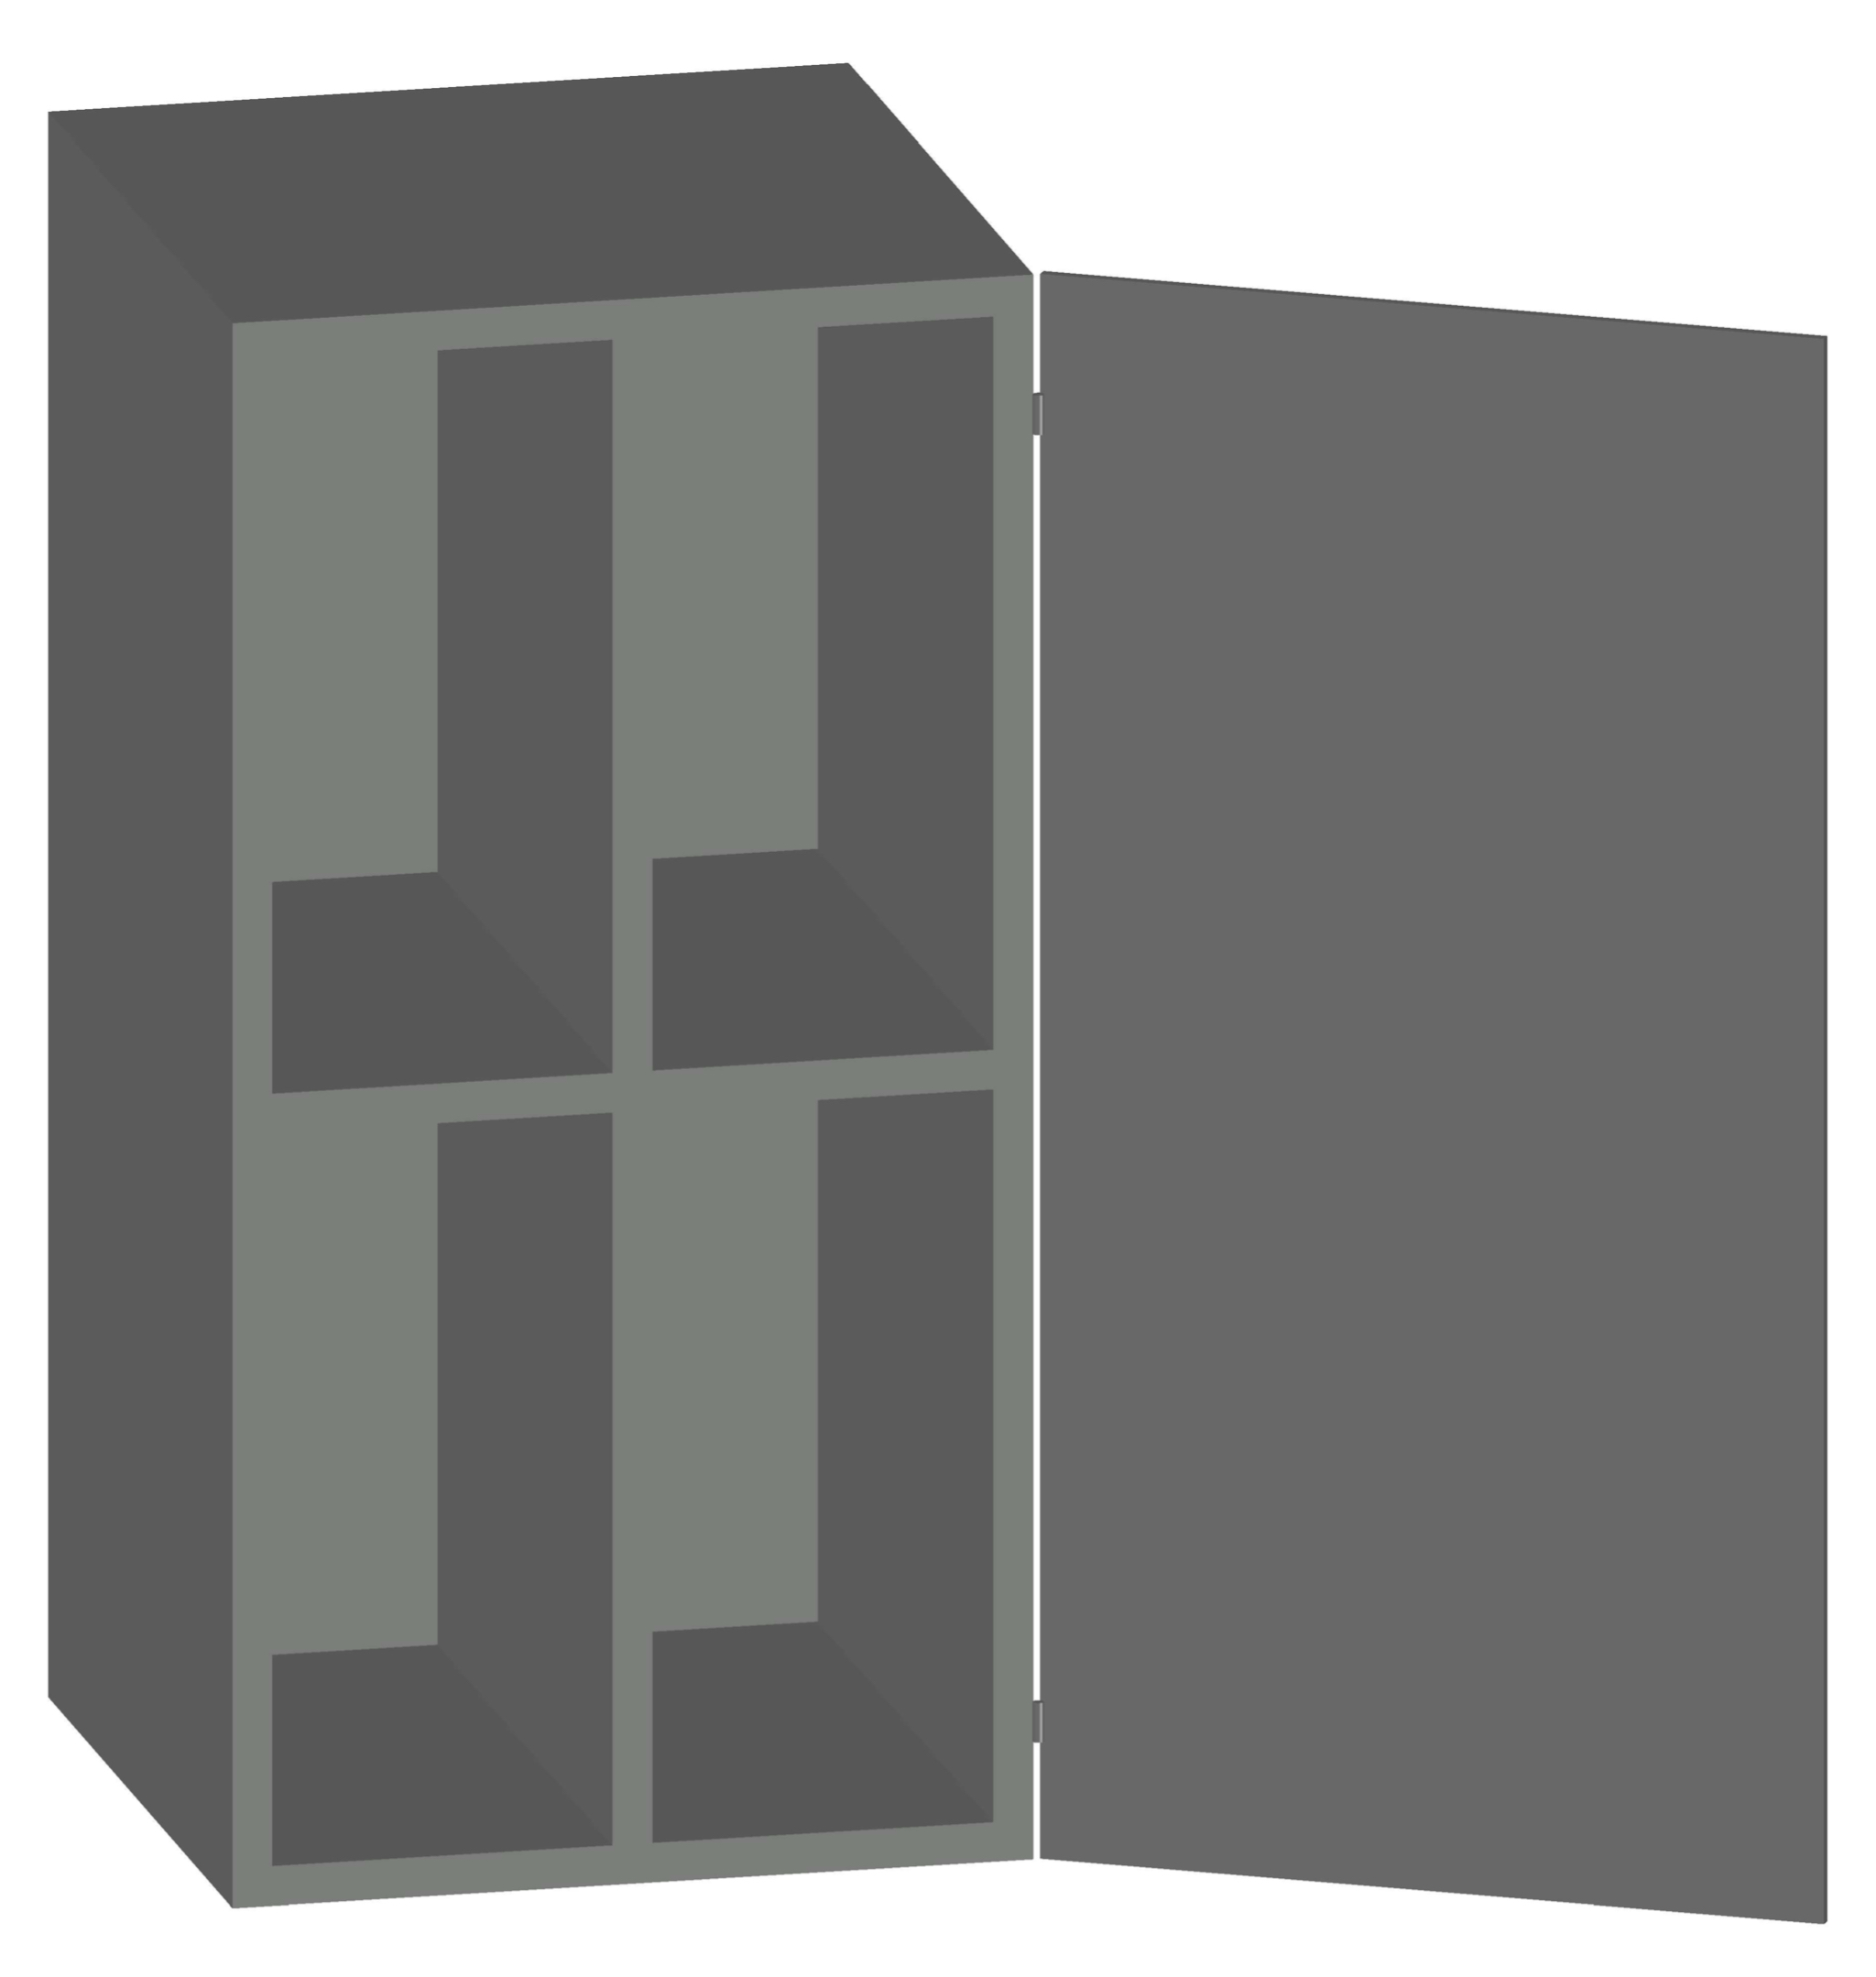
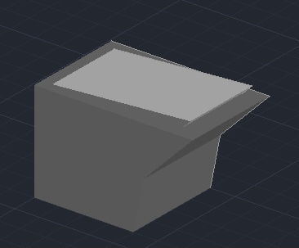
8) Initial Prototype Design

Slide 35
8) Initial Prototype Design
Available empty unit volume =
** Volume reserved for hardware approx = 2764.8 in^3 = 45306.9 cm^3 = 45.3 L

Slide 36
9) Problems/ surprises encountered
Obtaining a 12- or 24-volt power supply for the solenoid valves
Controlling multiple misters and solenoid valves at the same time
Finding a suitable relay board.
Tweaking the Temperature Sensors‘ test code when researching the appropriate components

Slide 37
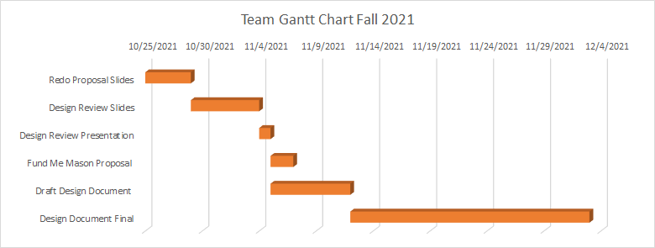
Gantt Charts

Slide 38
Gantt Chart

Slide 39
Individual Responsibilities
Cameron
Code for Solenoid Valves
Code for LCD Screen
Zach
Code for LCD Screen
Code for Relays
Ahmed
Code for Temperature/Humidity Sensors
Code for the switches

Slide 40
Individual responsibilities
Nestor
Soldering components
Mount interior and exterior components
Michael
Find access points and drill into fridge
Cut holes into A/C tubing and control wires
Matthew
Wire components
Run wires through the fridge

